Slide 1

Variables

Slide 2
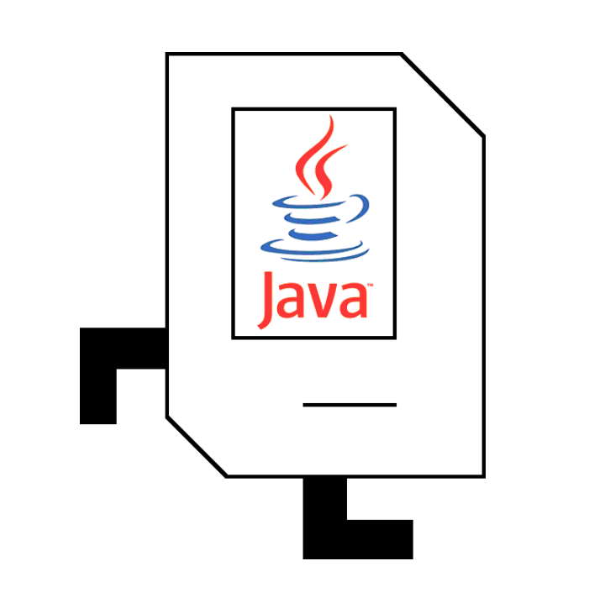
Review

Slide 3
Control Statements
private void solaDon() {
turnLeft();
}
method
for(int i = 0; i < N; i++) {
// to repeat N times
}
for-loop
while(condition) {
// all the code in here repeats
// while the condition is true
}
while-loop
if(condition) {
// do this code if true
} else {
// do this code if false
}
if-else statements
Notes:
Ask them what they think the difference is between the two types of loops

Slide 4
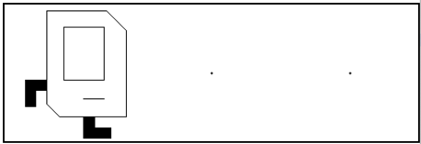
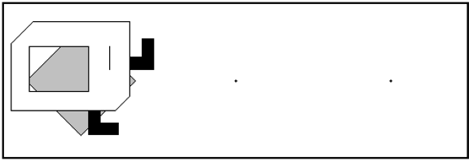
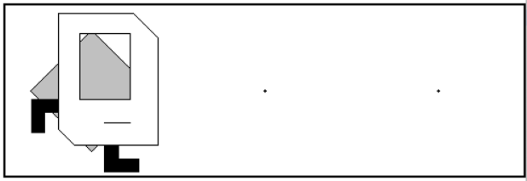
If-else statements
What do these two code snippets do?
(before)
if(frontIsClear()) {
putBeeper();
}
turnLeft();
if(frontIsClear()) {
putBeeper();
} else {
turnLeft();
}
✅
❌
(after)
(after)
🤔

Slide 5
Errors
What kind of bugs did you find in your code?
🤔

Slide 6
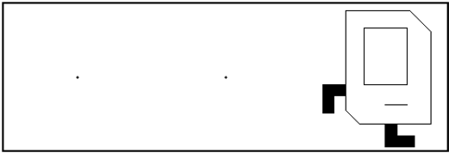
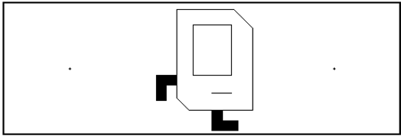


Semicolons and Curly Braces { }
This line is a command.
These lines are grouped.
;
{…}
What do these code snippets do?
(before)
while (frontIsClear()) {
move();
}
(running)
(done)
while (frontIsClear()); {
move();
}
🤔
(running)

Slide 7
Semicolons ; and Curly Braces { }
while (frontIsClear()) {
move();
}
while (frontIsClear())
{
move();
}
(done)
while (frontIsClear()); {
move();
}
while (frontIsClear())
{
}
{
move();
}
(running)
“do nothing”
⚠️
We never reach here!

Slide 8
Make It a Habit
for (int i = 0; i < N; i++) {
move();
}
No semicolon between ( ) and { }
while (frontIsClear()) {
move();
}
No semicolon between ( ) and { }
if (frontIsClear()) {
move();
}
No semicolon between ( ) and { }
move();
A command

Slide 9
Questions?

Slide 10
Asking for Help
We love helping…
…but we love it when you help us help you.
Notes:
Section leaders are not debuggers.
There are lots of errors that eclipse can catch.
They are not solution manuals

Slide 11
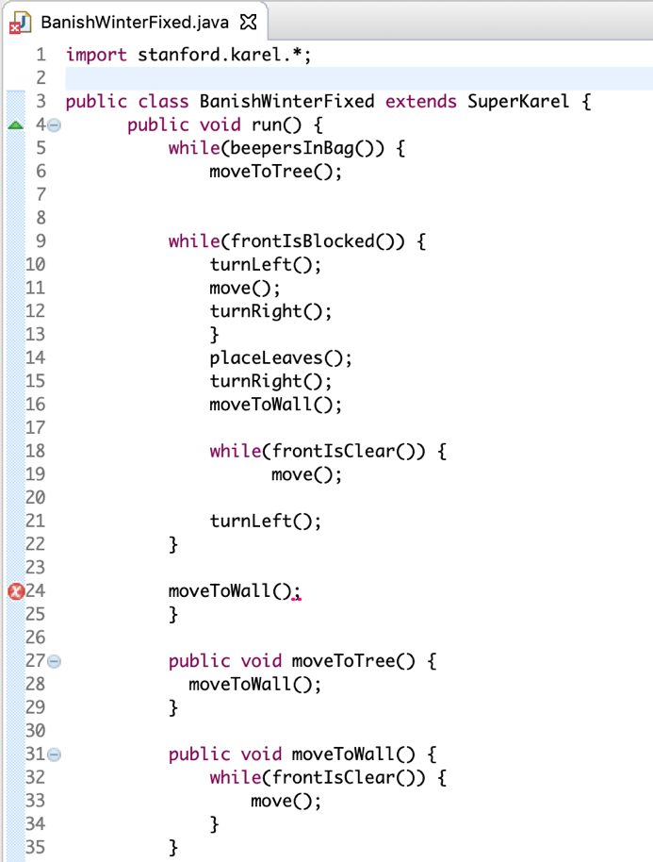
Eclipse Is Actually Your Friend
My code doesn’t work.
Syntax error, insert “}” to complete Block

Slide 12
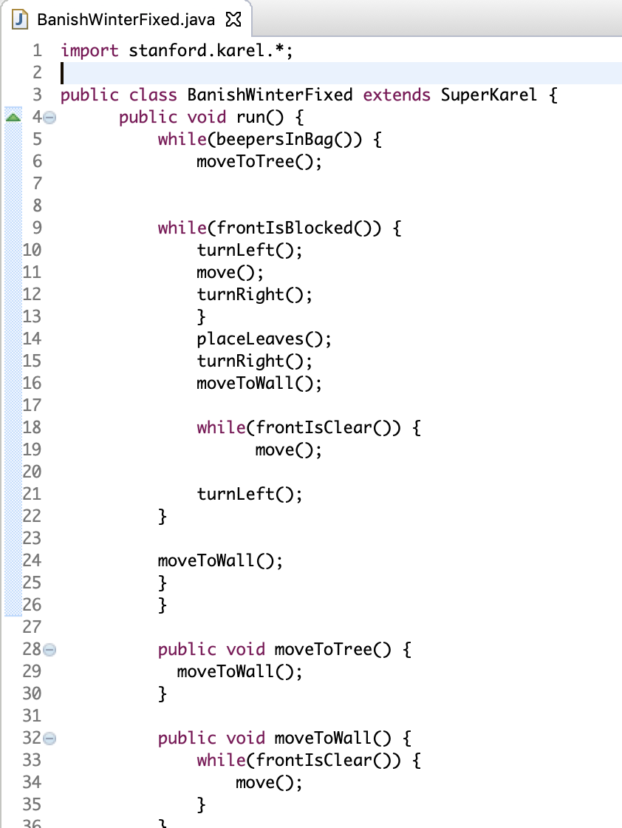
Style Is Also Your Friend
My code doesn’t work.
Okay, what does your code do?
I can’t read it.
Yeah me neither tbh

Slide 13
You Understand Your Code Best
Section Leaders are GREAT at…
Clarifying logic and strategy
Debugging
Making you feel at peace
You are just as good as Section Leaders at…
Reading (most) Eclipse errors
Fixing brackets { } and indentation
You are BETTER than Section Leaders at…
Explaining your own code
Coding your own program

Slide 14
Programming takes practice.

Slide 15

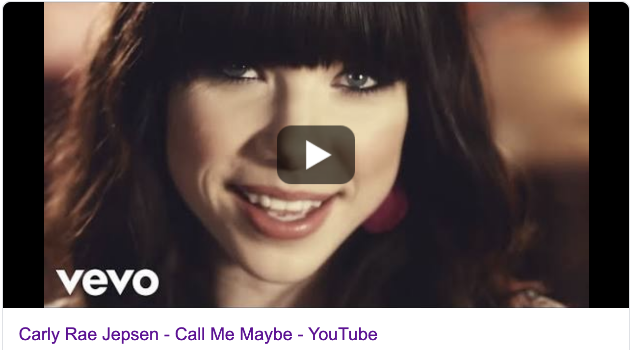
See You Later!
I will miss you.
Enjoy Java!
Call me maybe?
(2012)

Slide 16


Java

Slide 17
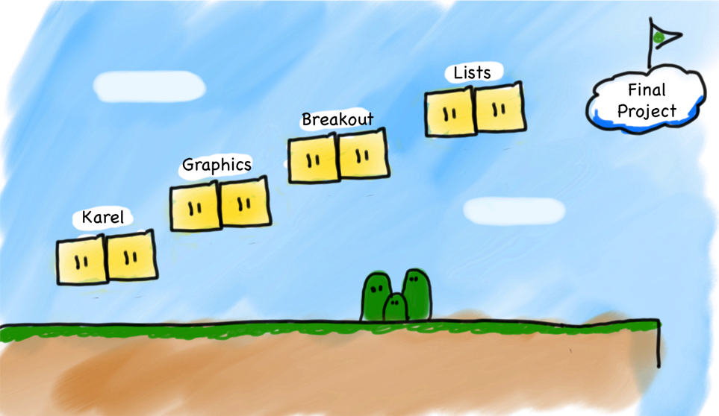
Our First Step
Console
Programs
Notes:
Let's just jump straight into it!

Slide 18


Today’s Goals
How do I write a console program?
What are variables and how do I use them?
How do I get user input in a console program?

Slide 19
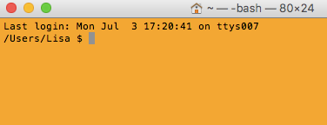
Console Program
Takes text input
Prints text output

Slide 20

First Console Program: Hello World
import acm.program.*;
public class HelloProgram extends ConsoleProgram {
public void run() {
println("hello, world");
}
}
HelloConsole
hello, world

Slide 21


In Pop Culture
Notes:
Now you’re in on the joke

Slide 22
Today’s Goals
✓
How do I write a console program?
What are variables and how do I use them?
How do I get user input in a console program?

Slide 23
What is a variable?

Slide 24
[suspense]

Slide 25
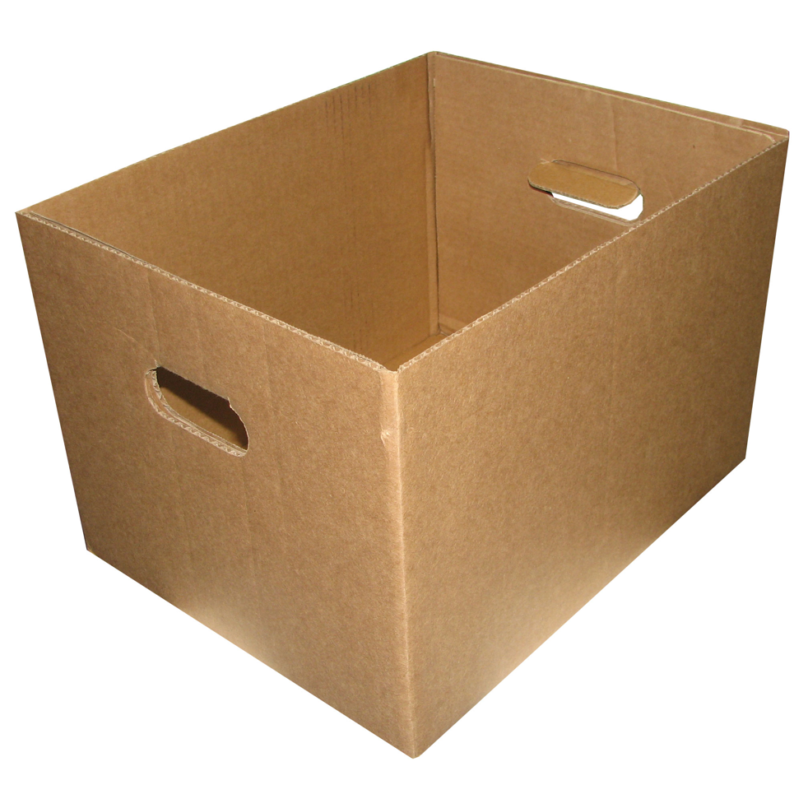
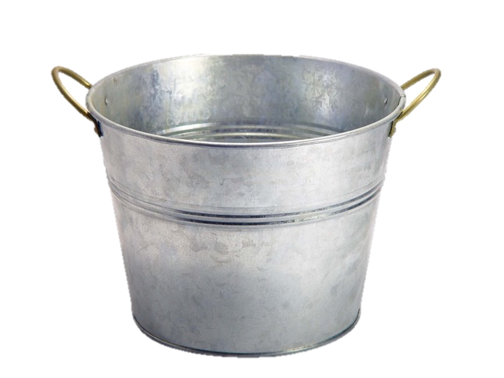
Variables are Like Boxes

Slide 26
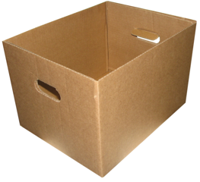
Teeny Tiny Boxes
My computer has space for about 64 trillion boxes

Slide 27
Variables are Like Boxes
type
name
value
int life = 42;
name
type
life
42
(contains an int)
value
Notes:
Type name = value

Slide 28
Types
// integer values
int num = 5;
// real values
double fraction = 0.2;
// letters
char letter = ‘c’;
// true or false
boolean isLove = true;

Slide 29
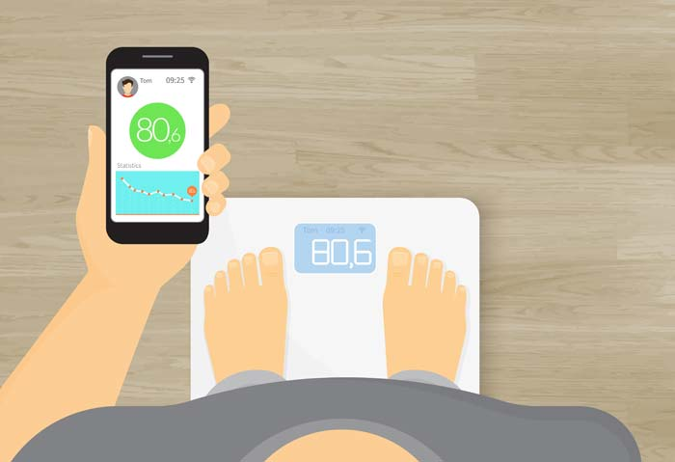
double: How Much Do I Weigh?
* Answers could be real valued numbers

Slide 30
int: How Many Children Do I Have?
* It is weird to say something like 1.7

Slide 31
Binary Operators
+
Addition
*
Multiplication
–
Subtraction
/
Division
%
Remainder

Slide 32
Binary Operators
double width = 2.5; // meters
double height = 3.0;
double area = width * height;
name
width
height
area
2.5
3.0
7.5
value
type
double
double
double

Slide 33
Today’s Goals
✓
How do I write a console program?
What are variables and how do I use them?
How do I get user input in a console program?
✓

Slide 34
User Input
int a = readInt(“Give me an int!”);
double b = readDouble(“And a double”);

Slide 35
Add2Integers
public class Add2Integers extends ConsoleProgram {
public void run() {
println("This program adds two numbers.");
int n1 = readInt("Enter n1: ");
int n2 = readInt("Enter n2: ");
int total = n1 + n2;
println("The total is " + total + ".");
}
}
n1
n1
n2
n2
total
total
17
25
42
Add2Integers
This program adds two numbers.
Enter n1:
17
Enter n2:
25
The total is 42.

Slide 36
Questions?

Slide 37
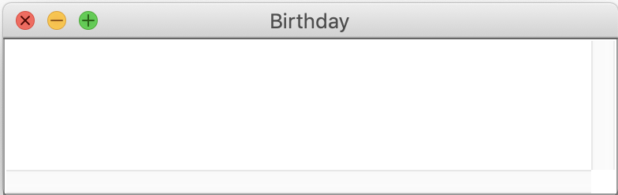
Birthday
This program celebrates birthdays.
Enter your age:
27
Happy birthday!
You are now 28.

Slide 38
Birthday
public class Birthday extends ConsoleProgram {
public void run() {
println("This program celebrates birthdays.");
// creates a new int variable age
???????????? = readInt("Enter your age: ");
// increments the age variable by one
????????????
println("Happy birthday!");
println("You are now " + age + ".");
}
}
This program celebrates birthdays.
Enter your age:
27
Happy birthday!
You are now 28.

Slide 39
Let’s try it!

Slide 40

Birthday
(1)
int age = readInt("Enter your age: ");
(1) Get a new int box.

Slide 41
Birthday
(1)
(2)
int age = readInt("Enter your age: ");
(1) Get a new int variable.
(2) The variable’s name is age.
age

Slide 42

Birthday
(1)
(2)
(3)
int age = readInt("Enter your age: ");
(1) Get a new int box.
(2) The variable’s name is age.
(3) Evaluate the right-hand side.
age

Slide 43
Birthday
(1)
(2)
(4)
(3)
int age = readInt("Enter your age: ");
(1) Get a new int box.
(2) The variable’s name is age.
(3) Evaluate the right-hand side.
age
27
(4) Set the value of age’s to the right-hand side.

Slide 44
Incorrect Birthday
int age = readInt("Enter your age: ");
(1)
(2)
int
age = age + 1;
(1) Get a new int box.
(2) The variable’s name is age.
age
age
❌
Duplicate variable age
27

Slide 45
Birthday
int age = readInt("Enter your age: ");
(1)
(3)
(2)
age = age + 1;
(1) Get the variable named age.
(2) Evaluate the right-hand side.
28
(3) Set the value of age’s to the right-hand side.
age
27
28

Slide 46
Questions?

Slide 47
What do you think this does?
println(1 / 2);

Slide 48
AHHHHHHH!!!!!!
println(1 / 2);

Slide 49
Resulting Type
int + int results in an int
double + double results in a double
int + double results in a double
* The general rule is: operations always return the most expressive type

Slide 50
Pitfalls of Integer Division
Convert 100 ˚Celsius temperature to its ˚Fahrenheit equivalent:
double c = 100;
double f = 9 / 5 * c + 32;
The computation consists of evaluating the following expression:
9 / 5 * c + 32
The problem arises from the fact that both 9 and 5 are of type int, which means that the result is also an int.
132
100
1
9 / 5 * c + 32

Slide 51
Pitfalls of Integer Division
You can fix this problem by converting the fraction to a double, either by inserting decimal points or by using a type cast:
double c = 100;
double f = 9.0 / 5 * c + 32;
The computation now looks like this:
212.0
180.0
1.8
9.0
/ 5 * c + 32

Slide 52
Conditions

Slide 53
Conditions
<
Less Than
==
Equal To
>
Greater Than
>=
More or Equal
<=
Less or Equal

Slide 54
Equal or Equals equals?
Set variable
double c = 100;
“equals”
=
c = 25;
Equivalent
“equals equals”
if (c = 100) {
println(”Hi!");
}
==

Slide 55
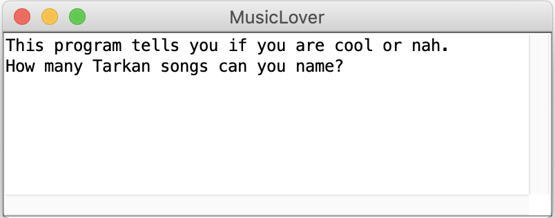
Music Lover
Music Lover
User enters an int:
Exactly 1
More than 3
Anything else
Print out:
You only know Yolla!
Okay, you’re pretty cool.
I don’t know anymore.

Slide 56
Demo

Slide 57
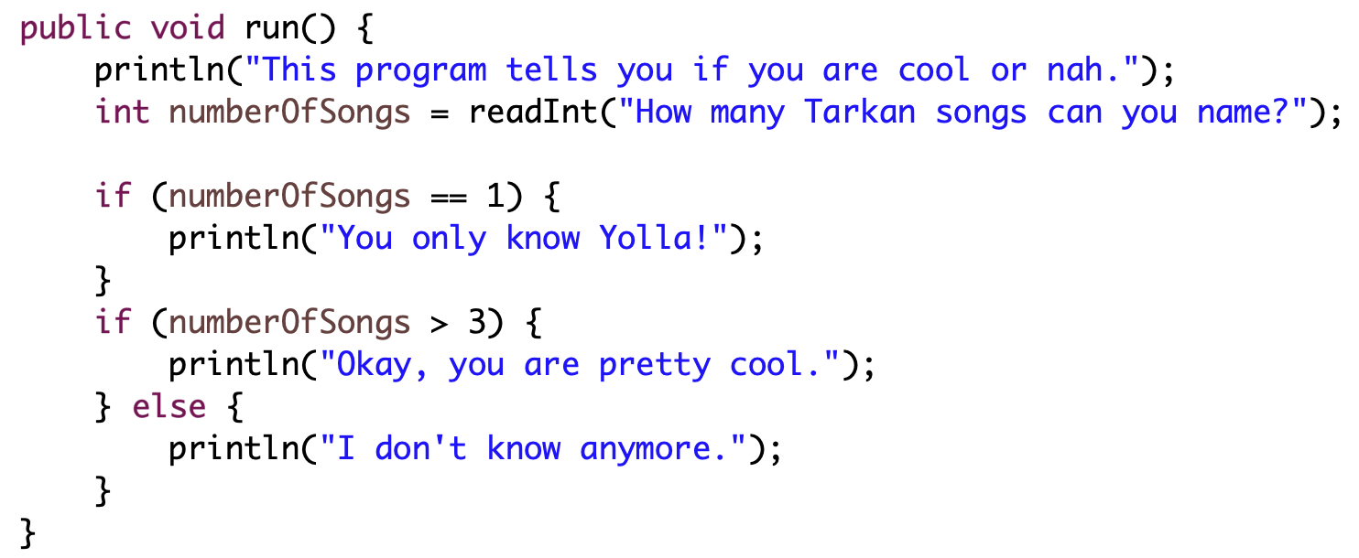
Music Lover

Slide 58
Today’s Goals
✓
How do I write a console program?
What are variables and how do I use them?
How do I get user input in a console program?
✓
✓

Slide 59

Sandcastles

Slide 60
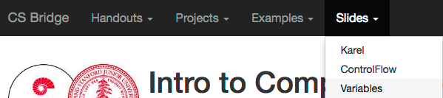
Website

